Slide 1

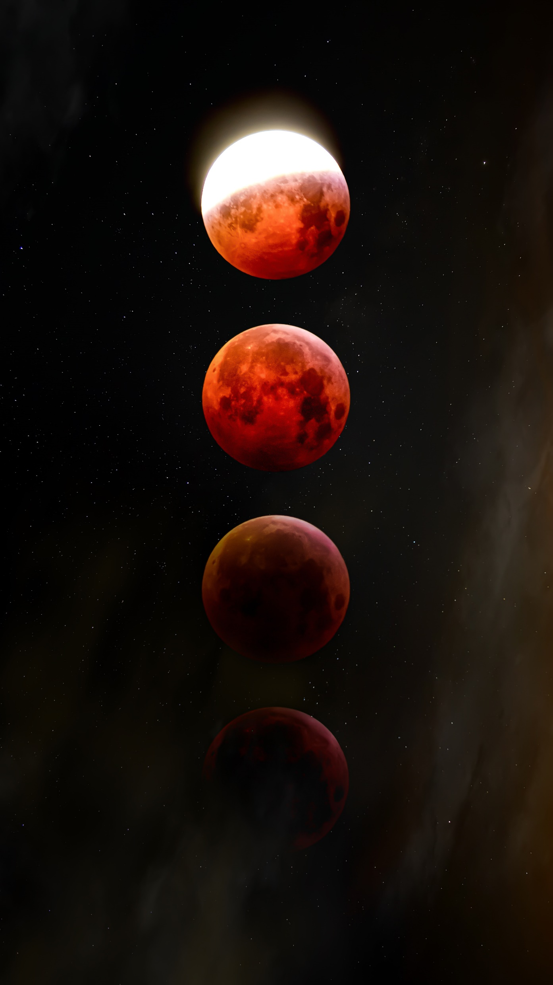

Slide 2

CHALLENGE:
To create an activity, game, or story (through words, art, video, graphic novel, or other artistic means) that explains the mechanics of eclipses.

Slide 3
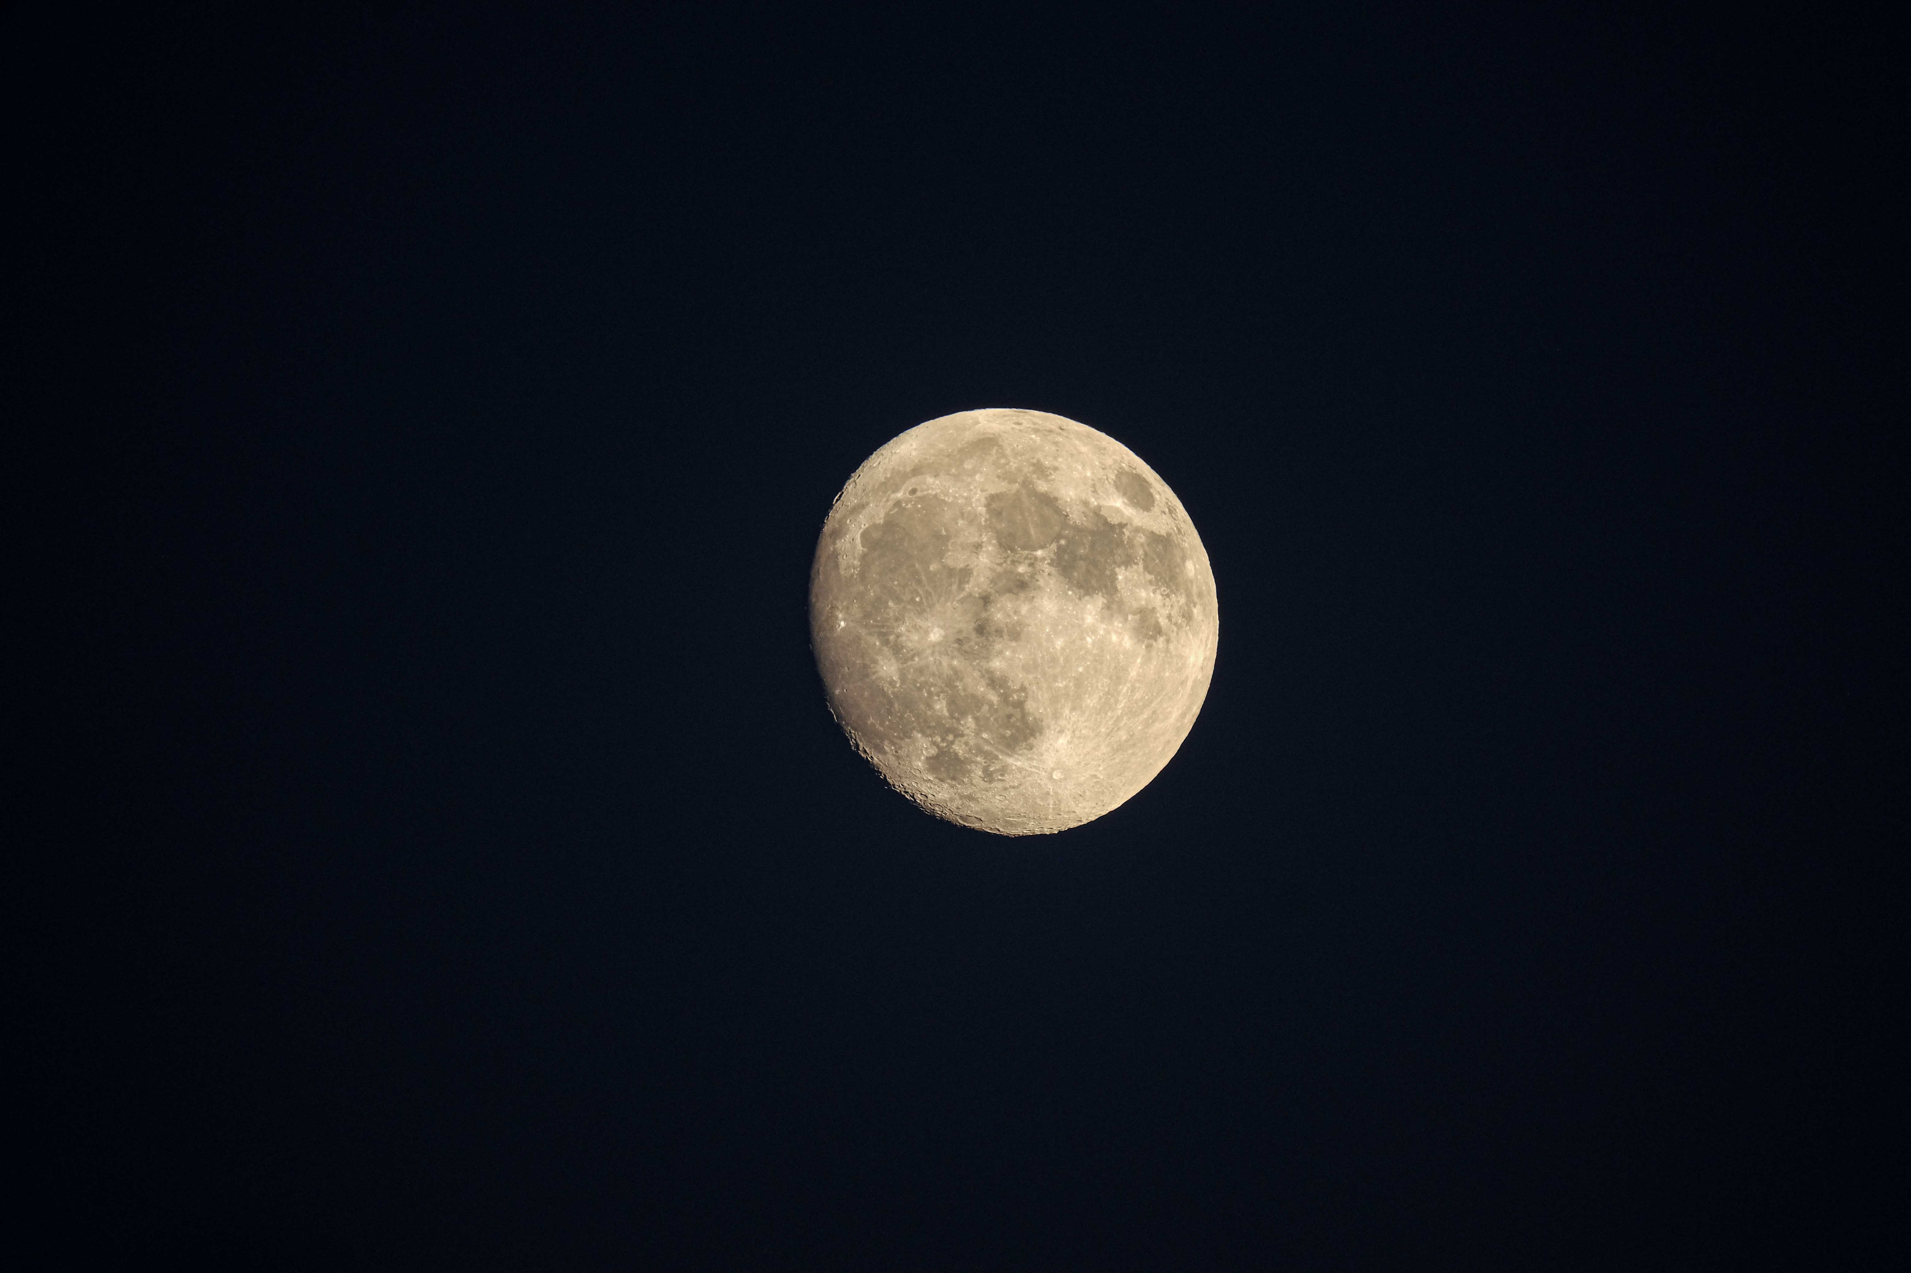

SOLUTION:
An in-depth and informative website dedicated to the exploration of solar and lunar eclipses.
Our aim is to bridge the gap between scientific knowledge and public fascination, making the marvels of the cosmos accessible to individuals of all backgrounds. We are committed to maintaining a balance between scientific accuracy and user engagement, ensuring that our website serves as a valuable resource for eclipse enthusiasts, educators, and the intellectually curious.

Slide 4

Home:
-> Home page prominently offers a concise introduction to the website's purpose and content.
-> Additionally, we have included a featured video that provides a comprehensive and visually engaging explanation of the phenomenon of eclipses, simplifying intricate astronomical concepts for a broader audience.
Experience:
-> This section immerse users in the wonder of the 2023 annular solar eclipse with a 3D model implementation. This feature allows users to explore this celestial event from various perspectives, enhancing their understanding of its mechanics.
Eclipse Map:
-> Access an eclipse map that provides detailed information on the dates and locations of upcoming eclipses. Users can select their region on a world map to obtain accurate eclipse predictions tailored to their location.Future preductions of the Eclipse is a possibility from the Map.

Slide 5
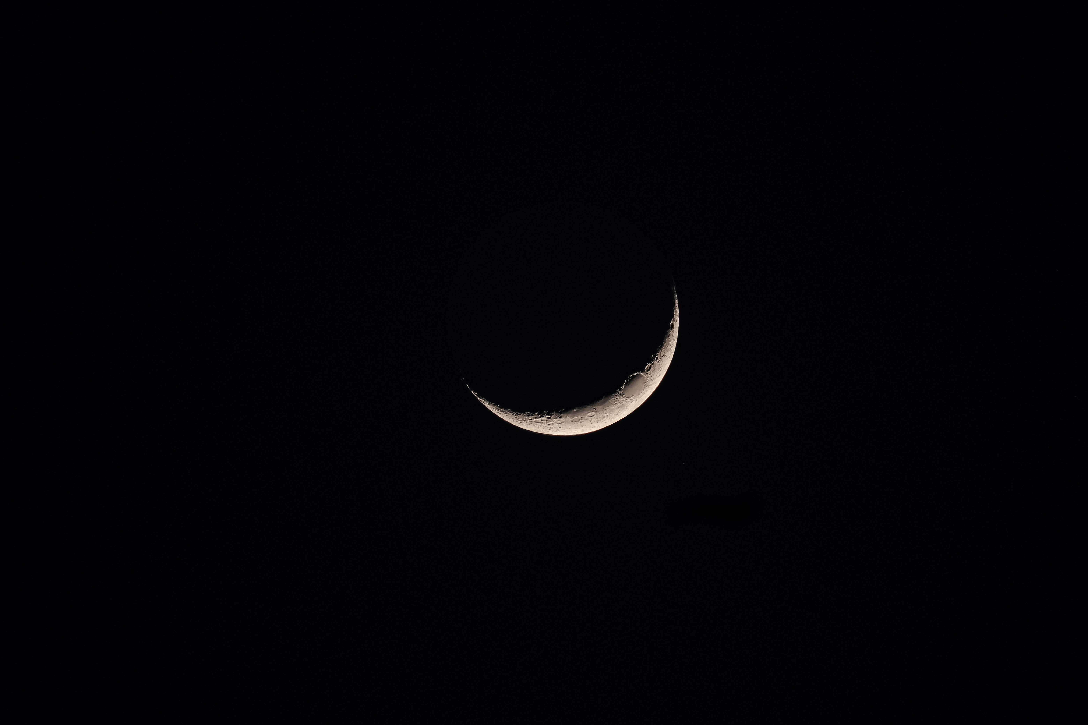
ECLIPSE CALENDER: -> Access an eclipse calendar that provides detailed information on the dates and locations of upcoming eclipses. Users can select their region on a world map to obtain accurate eclipse predictions tailored to their location.
FACTS : -> Our dedicated section on eclipse facts offers a wealth of information:
Fun Facts: Discover intriguing and lesser->known facts about solar and lunar eclipses, sparking curiosity and amazement.
-> Historic Events: Explore pivotal moments in history where eclipses played a central role, influencing scientific discoveries and cultural beliefs.
-> Frequently Asked Questions: Find comprehensive answers to common queries, enriching users' understanding of these celestial phenomena.
-> Basic Details: Gain a solid foundation in the fundamentals of eclipses, encompassing their various types, causes, and significance in the realm of astronomy.
ECLIPSE GALLERY:Immerse in the visual splendor of past eclipses through our captivating image gallery. Each image is accompanied by the date and location of the eclipse, allowing users to relive these remarkable events.

Slide 6
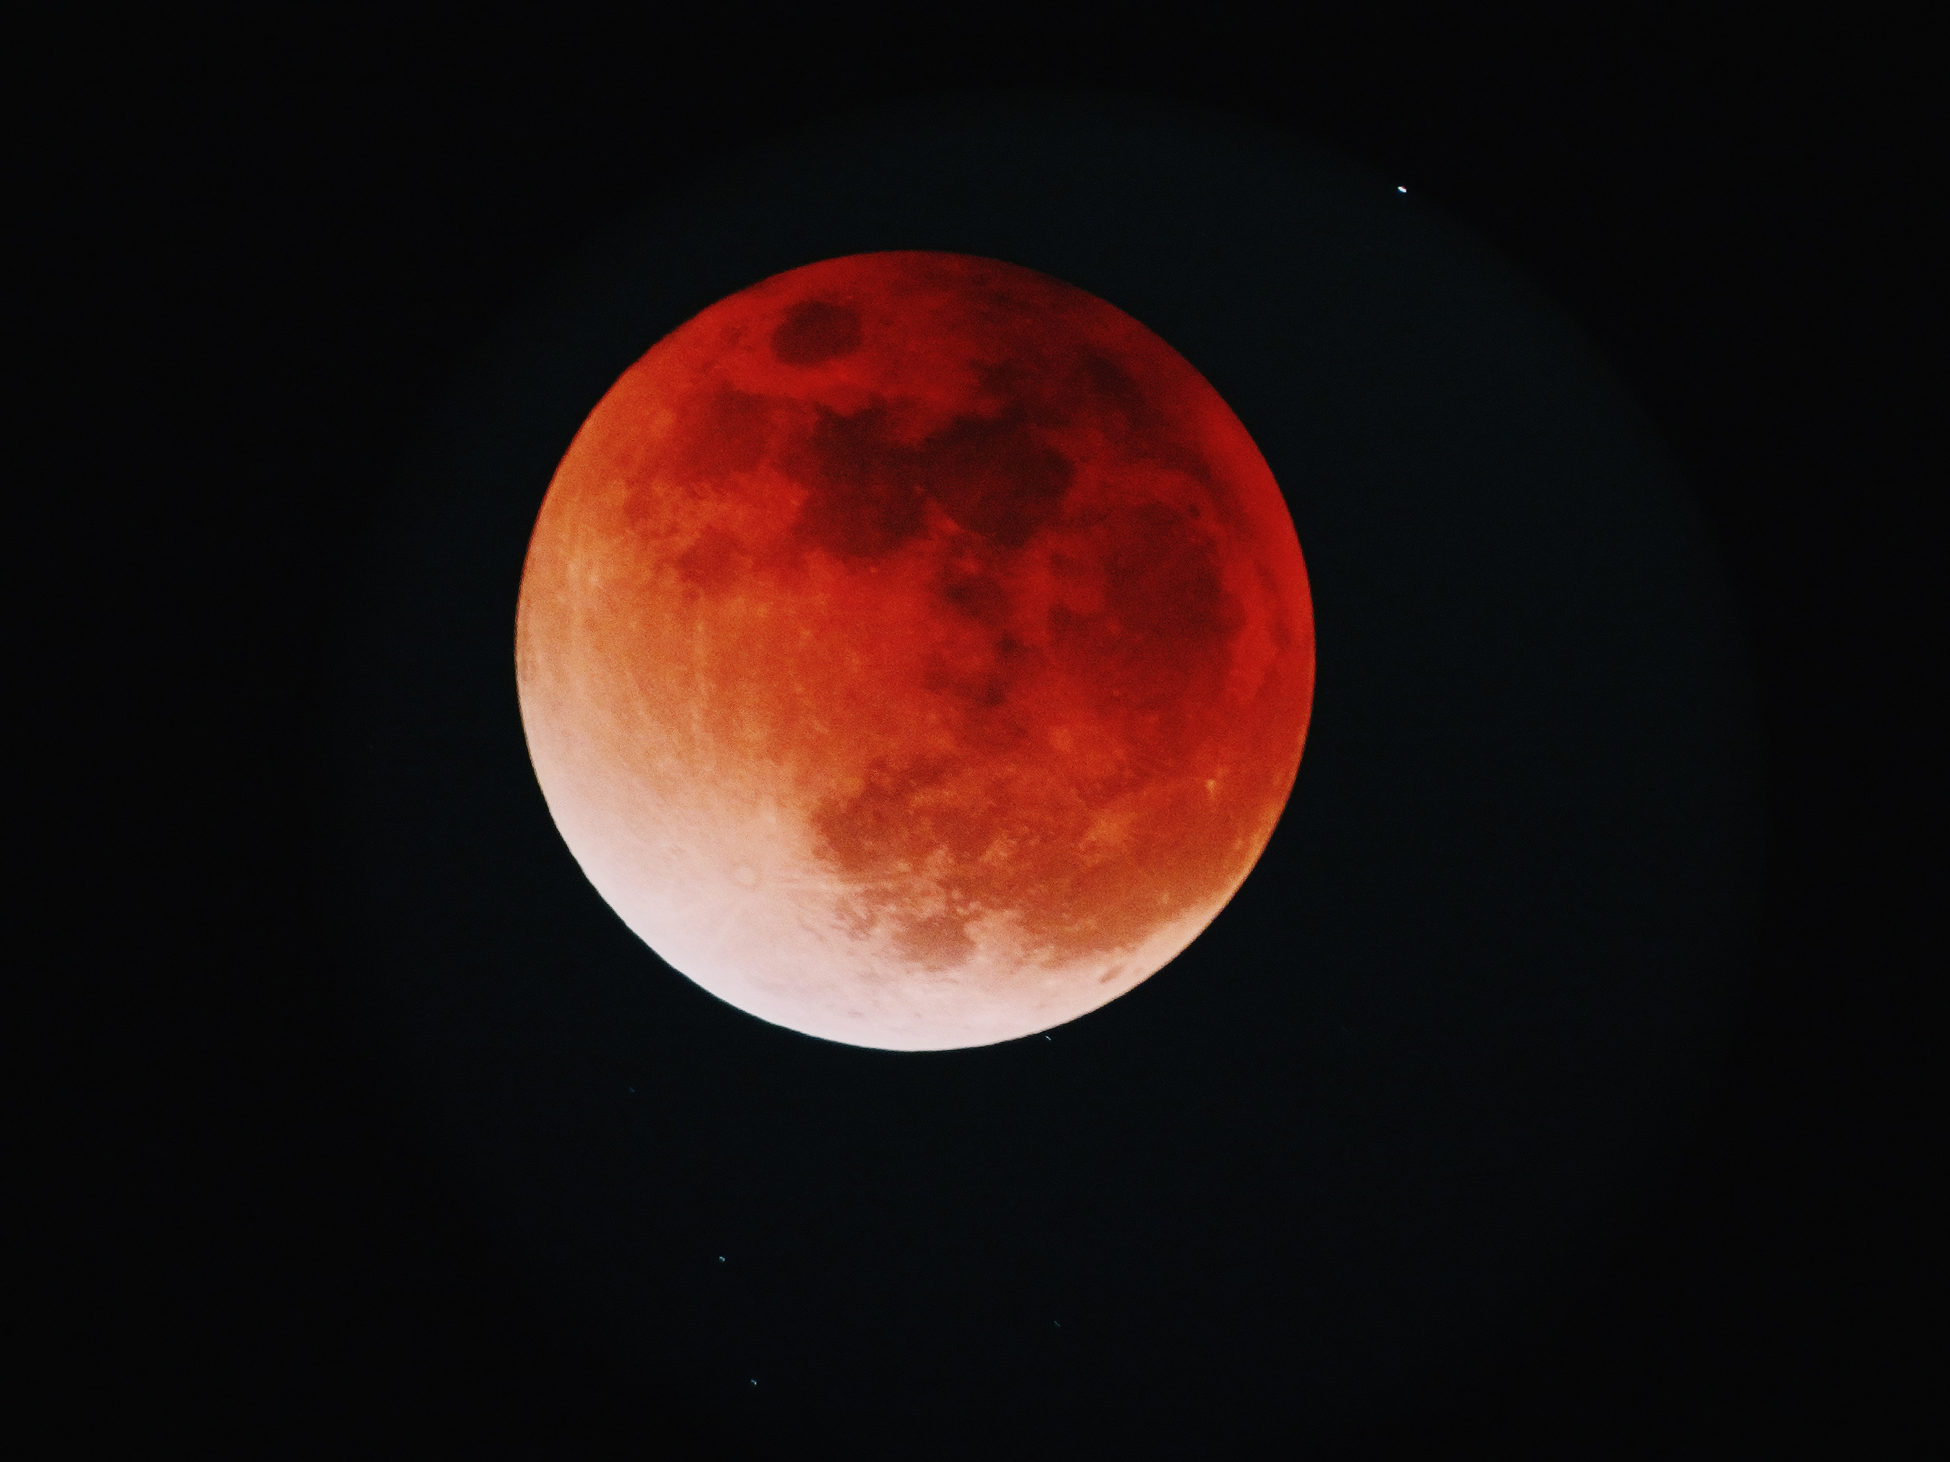
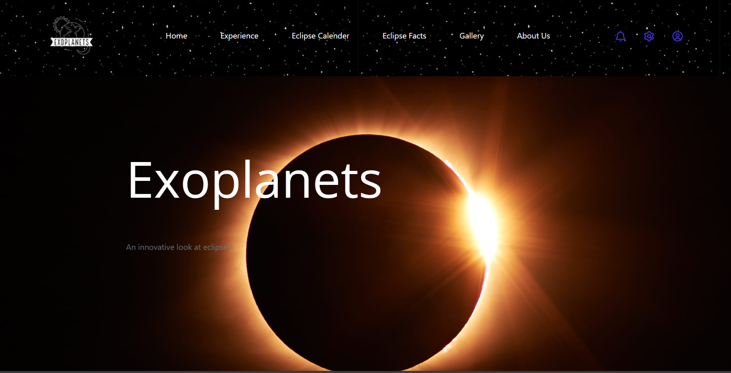
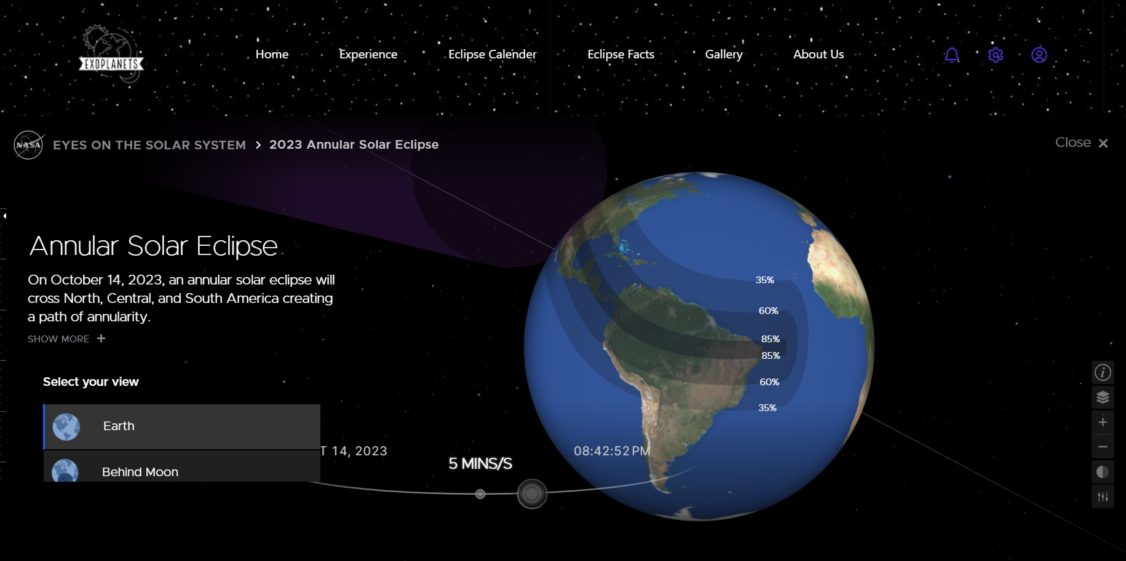
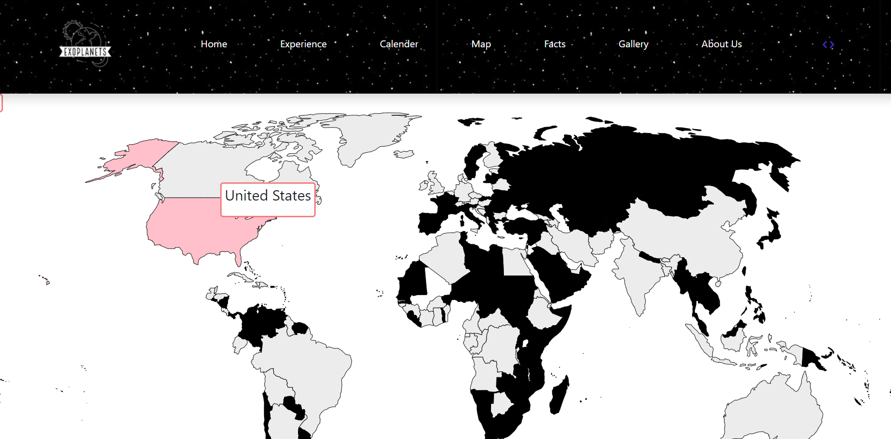
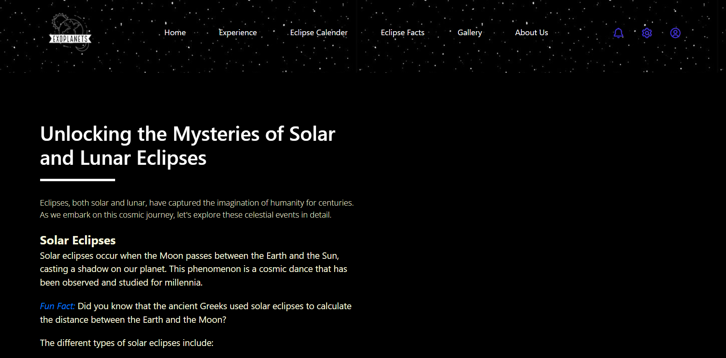

Slide 7
Why "Exoplanets"?
"Exoplanets" distinguishes itself from conventional eclipse websites by amalgamating immersive experiences, precise information, and user->friendly features. Our aim is to bridge the gap between scientific knowledge and public fascination, making the marvels of the cosmos accessible to individuals of all backgrounds. Our commitment to excellence, both in content and user experience, ensures that users depart from our website with an enriched appreciation of the universe and a heightened desire to further explore its mysteries.
Join us on this celestial journey, and together, let's unlock the secrets concealed within solar and lunar eclipses. "Exoplanets" – Where Science Meets Wonder. 🌘✨

